Slide 1
Comprehensive Sexuality Education: South Africa
Nomtika Mjwana
Sexual and Reproductive Justice Coalition

Slide 2
Focus on CSE
ASRHR Framework
Life Orientation subject policy brief
Online tools by the NDoH
SRJC engagement and efforts
Recommendations

Slide 3
Adolescent SRHR framework
Coordinated by Department of Social Development
Cabinet directive – to Basic Education, Higher Education, Health, Women etc. and Social Development
Abortion and LGBTI
Priority 1 – Increased coordination, collaboration, information and knowledge sharing on ASRH&R activities amongst stakeholders;
• Priority 2 – Developing innovative approaches to comprehensive SRHR information, education and counselling for adolescents;
• Priority 3 - Strengthening ASRH&R service delivery and support on various health concerns; •
Priority 4 – Creating effective community supportive networks for adolescents; and •
Priority 5 – Formulating evidence based revisions of legislation, policies, strategies and guidelines on ASRH&R.

Slide 4
Comprehensive Sexuality Education - Life Orientation
Provide an overview of the current research that has been conducted on Life Orientation (LO) sexuality education in the South African context.
Referred to as Life Orientation (LO) compulsory
Five emerging themes
1. Bombards learners with ‘disease, danger and damage’
Negative consequences of sex (pregnancy, HIV) little attention to pleasure.
Told what NOT to do
Linked to abstinence
This does not link to realities of youth sexuality and cultures – sexualities fluid – source of conflict and pleasure
Sex positive view
Attentive to cultural contexts and expressions of sexuality
2. Unknowingly promote rigid versions of gender - some underlie sexual violence
Fixed bodies – men lead in sexuality, women take responsibility – identify as vulnerable and passive. Women police male sexuality at the same time men's desires and needs privileged – contradictions
Disrupt the gender order that privileges male power and desire
Complexity of women’s role in maintaining gender order acknowledged and challenged

Slide 5
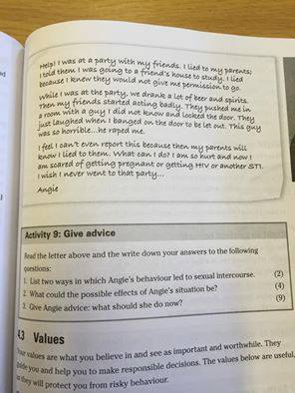
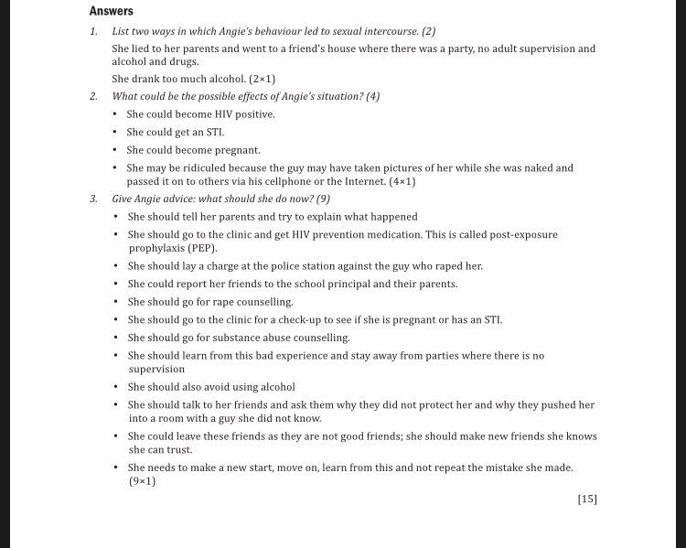

Slide 6
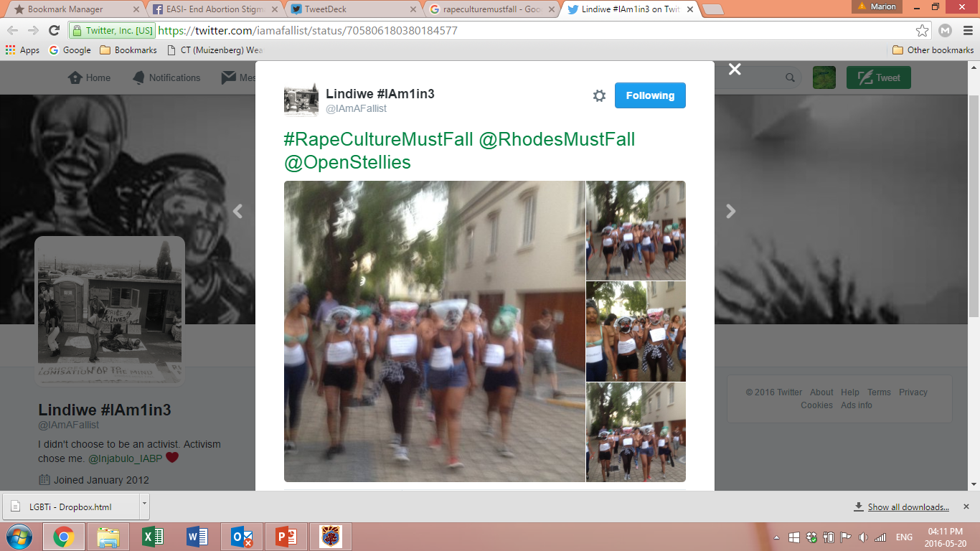
While….
Rape endemic
MRC data – one in four have raped, most before the age of 20
Over 40% will be raped in life time
One in nine reported
14% convicted
#RapeCulturemustfall
Protest
Legacy of trauma, conflict – all cultures
Directly linked to Sexual and Reproductive Health

Slide 7
3. Disconnection – disengaged/detached attitudes in relation to LO
Non relational style of LO – authoritarian , content often irrelevant in their lives. Content does not echo the complexity of sexualities or behaviours
Repetitive - learn more from peers than class
Young people viewed as asexual
Learner focused initiatives need to be encouraged
LO must provide space for in-depth interactions and discussions
4. Heteronormativity and Homophobia
Culture of heteronormativity – cultures of silence and homophobia
Strong resistance from parents
Teachers lack guidance
Teachers need training in issues related to sexual and gender diversity
Teachers need to be encouraged to reflect on their own beliefs, cultures and biases
5. Teachers underprepared and under supported
Teachers engage in care work – from pregnancy, HIV to violence
Contradictions – person – curriculum and school. Discipline complex
Difficulties ned to e acknowledged and teachers provided with support
Clear protocols concerning reporting sexual violence or other difficulties need to be established and teachers need to be able to debrief
(Policy Brief – April 2016 Catriona McCleod - Critical Studies in Sexualities and Reproductive Research Programme – SRJC

Slide 8
DoH Platforms-Bwise Health, website, SM
Online CSE platform for in and out of school adolescents with access
Very poor and problematic content
Also suggests messages of disease, danger and damage
No information whatsoever on abortion- even on website or SM- direct result of US funding
If abortion is mentioned, very blaming and suggests young women use abortion as contraception (28/09/2016)
No sex positive content
Not normalising of the female condoms/dental dems etc. v heteronormative
Teen Pregnancy research shows that young people admitted to having sex for pleasure

Slide 9
So…what are we doing?
SRJC website the only website with abortion information in SA
Looking at doing consulting work for NDoH on content and media
SRJC members run a series of workshops on various CSE themes
SRJC youth workshops on key pops (new partnership with IAS)
Sit on NPU task team for ASRHR with DSD
SRJC invited to be on ASRHR content team for CSE update following study visit to Sweden by intergovt team

Slide 10
#CSEGoals
Inclusive and realistic messaging that relates to lived experiences of young people
Sex positive content- we do not have sex to take risks. Sex is great and we have it for pleasure
Content that is not heteronormative/patriarchal or violent
Capacity building for teachers and healthcare workers
Actively engaging young people on CSE content

Slide 11
This is PERSONAL
“Within the context of the Sustainable Development Goals, this requires all stakeholders to move beyond a protectionist lens to consider how strategies to achieve each goal will impact the unique circumstances of young people, including through meaningful consultation with young people and investing in youth-led civil society organizations.” SRI, Youth Coalition, Youth for Choice and Dance4Life
Problematic distinction in LO

Slide 12
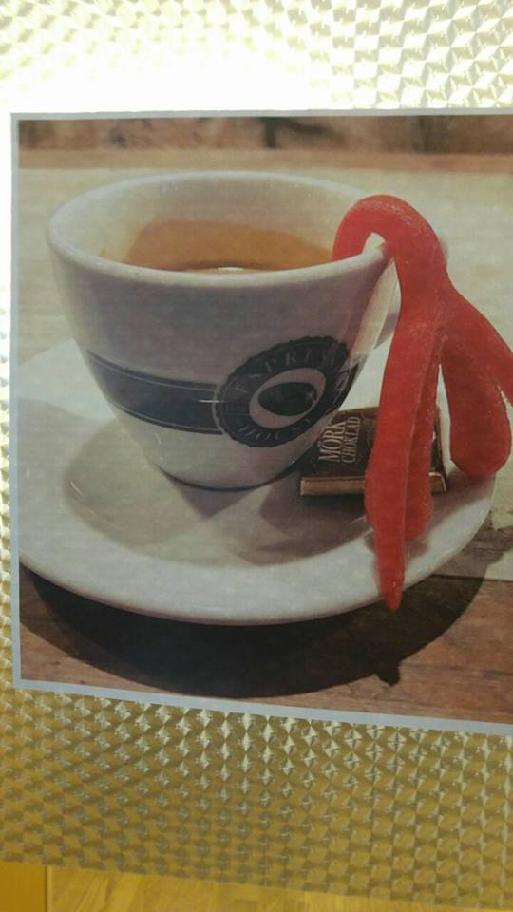
THANK YOU
Facebook: https://www.facebook.com/srjcza/
Twitter: @_SRJC
Website: www.srjc.org.za

